Slide 1

Capstone 4
Airline Passenger Satisfaction

Slide 2
Content:
Introduction
Methodology
Data Preparation
EDA & Data Analysis
ML Model Training
Evaluation
Conclusion

Slide 3



Introduction
Target Stakeholder:
The CEO of the airlines from the USA
The management of the customer services department
Ground Services
Flight/On-Board Services
Online/Internet/IT
Airlines Stock/Shareholders

Slide 4
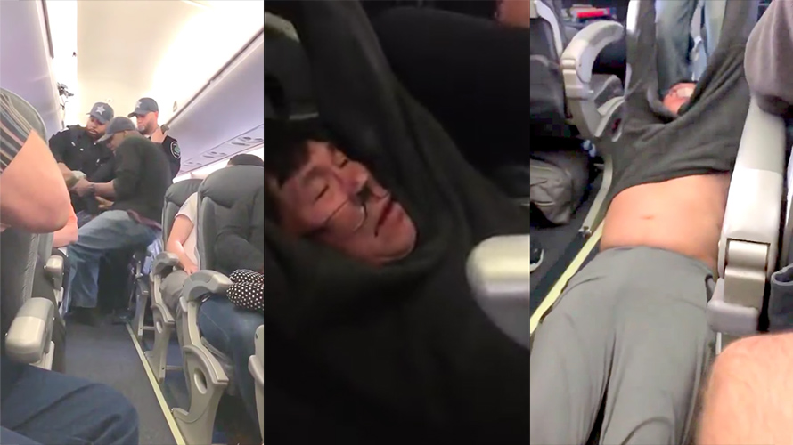



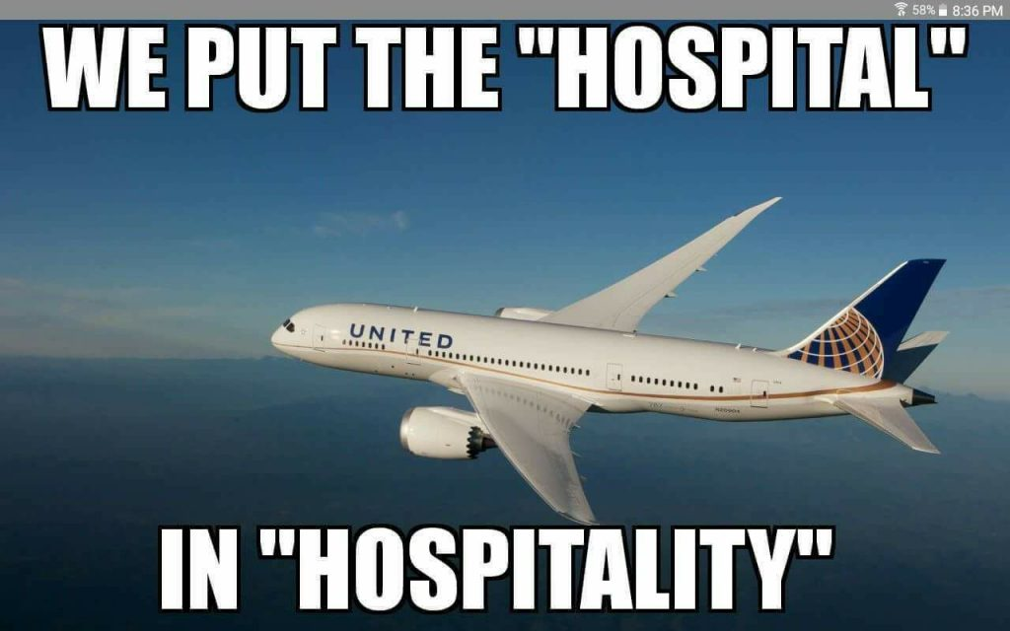
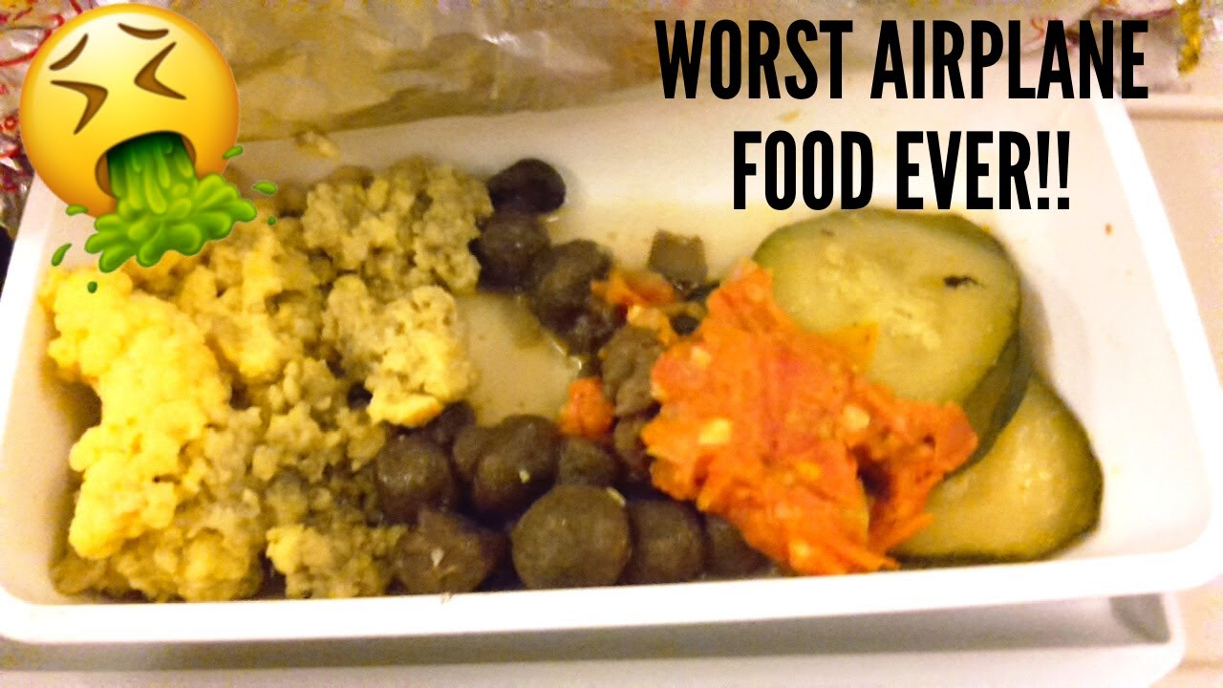
Introduction
Problem statement:
It is well-known for the Airlines in USA to provide MEMORABLE services
Hence we would like to analyst the factors that brings satisfactory or unsatisfactory ratings
Therefore hopefully creating a better airline branding that inspire confidence to all its stakeholders

Slide 5

Methodology
Source: Kaggle
https://www.kaggle.com/teejmahal20/airline-passenger-satisfaction

Slide 6
Methodology
Model: Decision tree, Random Forest
Metric: F1-Score
Tools: Pandas, Matplotlib, scikit-learn, etc

Slide 7
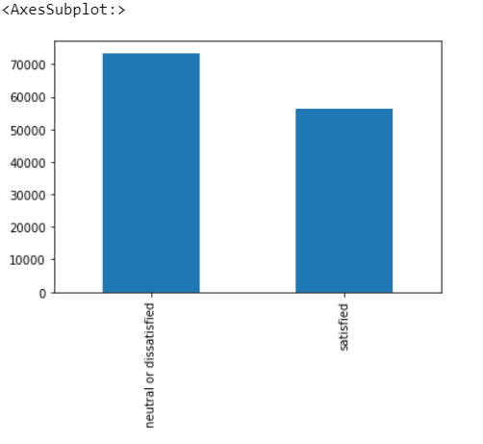
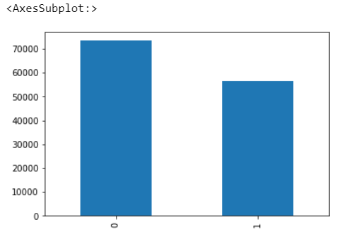
EDA & Data Analysis
Visualize how well balanced is the target (dependent variable)
Target (dependent variable) is Satisfaction

Slide 8
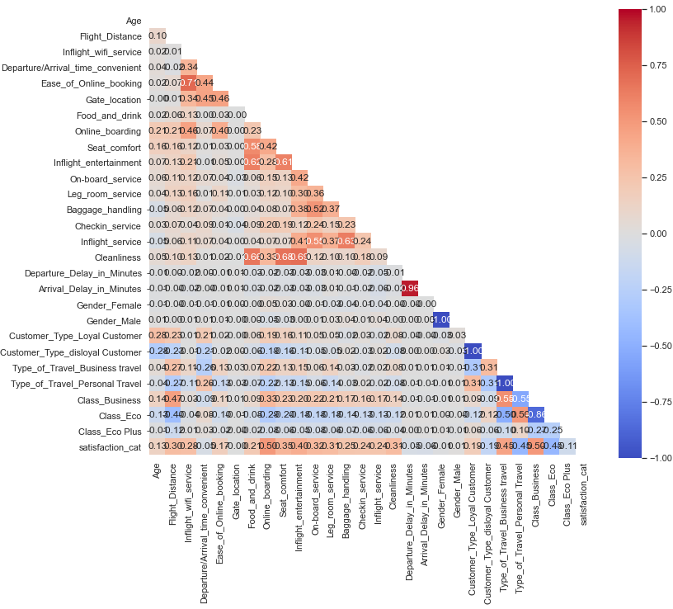
EDA & Data Analysis
Heat Map

Slide 9
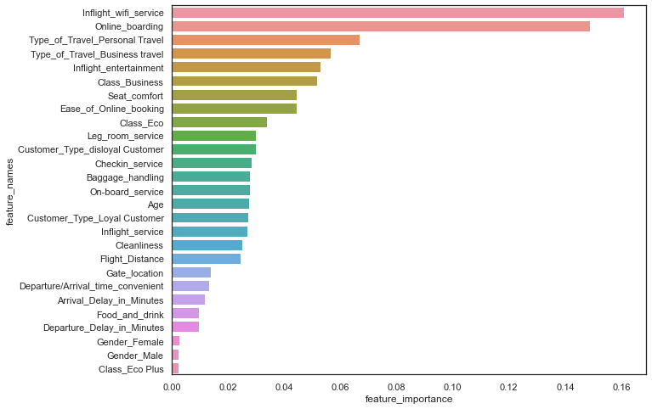
EDA & Data Analysis
Feature Importance

Slide 10
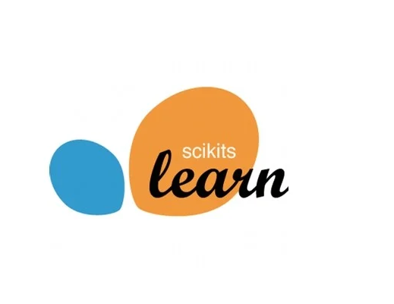
ML Model Training
Main Training Model
Decision Tree
Random Forest
Alternative (“Trying Out”) Model
SVM
Logistic Regression

Slide 11
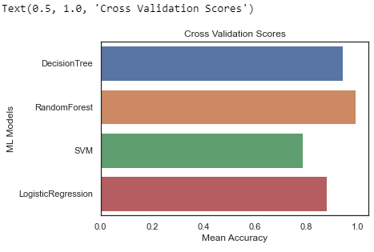
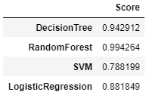
ML Model Training

Slide 12
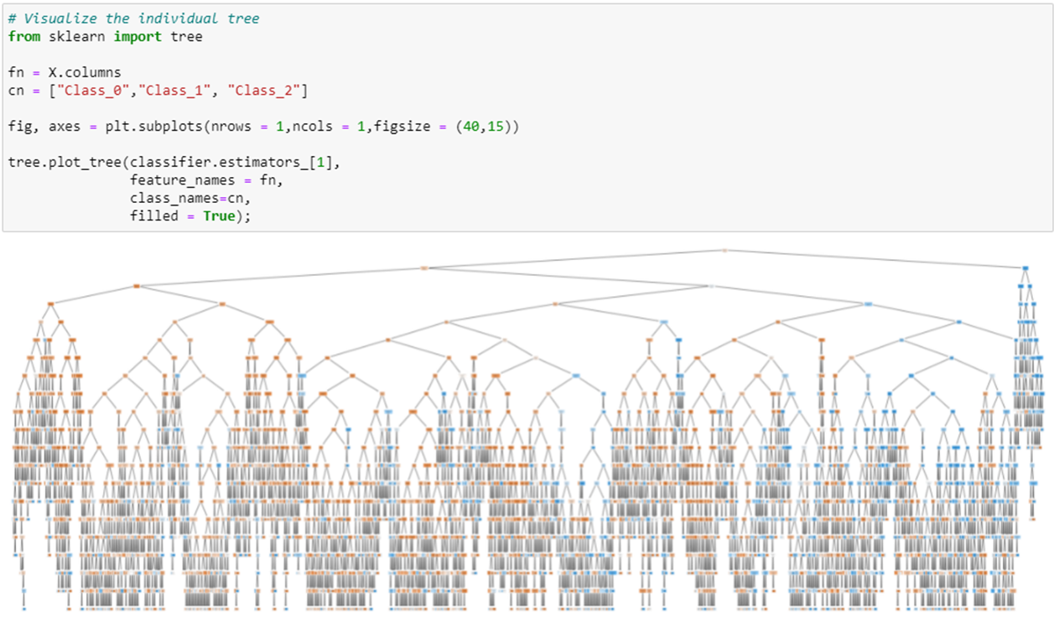
ML Model Training
Decision Tree Visualisation

Slide 13
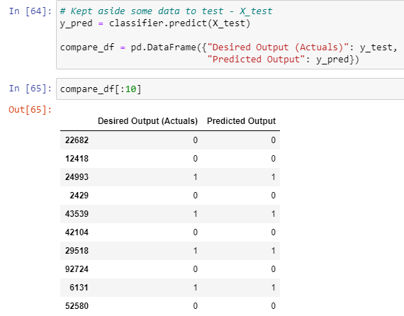
ML Model Training
Testing the ML Model

Slide 14
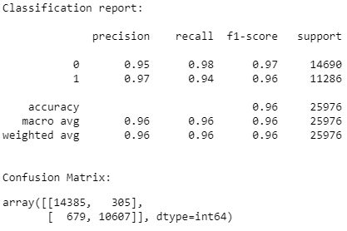
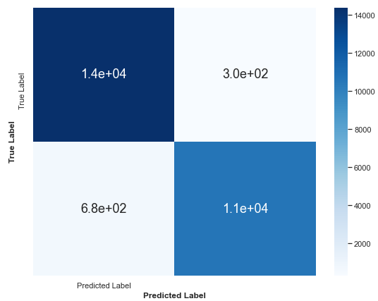
ML Model Training
Evaluate the model

Slide 15
Evaluation
Limitations of the Airline Dataset:
The Dataset is created in 2019, it does not reflect the changes in the industry due to Covid-19
Hence, the result of this dataset is very limited for the current year as of 2021
Limitations for using Random Forest:
It requires a lot of computational power as it builds numerous trees to combine their outputs
Large number of trees can make the algorithm too slow and ineffective for real-time predictions

Slide 16
Conclusion
Random Forest is the best ML Model for this Dataset
In-Flight Wifi and Online Boarding are very important satisfaction factors
Passenger on personal travel have higher satisfaction compared to business travel
Business class passengers have higher satisfaction compared to both economy classes

